Slide 1

Diabetes Disease Prediction
180030732-Sk.Khatuna

Slide 2
objective
Diagnostically predict whether a patient has diabetes or not
Diabetes has a great deal of attention in medical research
automated prediction about the Diabetes condition of patient
Shed away diabetes with proper treatment and spread happiness

Slide 3
Index
Introduction
01
System Analysis
02
Literature Survey
03
System Design
04
Conclusion
05

Slide 4
Introduction
Diabetes has a great deal of attention in medical research
Gestational Diabetes is a condition in which your blood sugar levels become high during pregnancy. It affects up to 10% of women who are pregnant in the U.S. each year. There are two classes of gestational diabetes. Women with class A1 can manage it through diet and exercise. Those who have class A2 need to take insulin or other medications. Gestational diabetes goes away after you give birth. But it can affect your baby’s health, and it raises your risk of getting type 2 diabetes later in life.

Slide 5
Algorithms Used:
Decision Tree Classifier
Gaussian Naïve Bayes
Random Forest Classifier
K-Nearest Neighbour
K-Means and Logistic Regression

Slide 6
SYSTEM ANALYSIS
Existing System
Hospitals maintain all the patient records. Even though, those records are not used in an efficient manner for diagnosis. To maintain the records in an efficient error free manner, the new proposed system is introduced

Slide 7
ADVANTAGES
DISADVANTAGES
1. Generates accurate and efficient results
2. Computation time is greatly reduced
3. Easy maintenance of patient records
4. Reduces manual work
5. Efficient further treatment
6. Automated prediction
1. Doesn’t generate accurate and efficient results
2. Computation time is very high
3. Difficulty in maintenance of patient records
4. Lacking accuracy may result in lack of efficient further treatment

Slide 8
Proposed System
To develop a system which will help practitioners to predict diabetes based on some diagnostic
measurements like number of pregnancies, age, gender, blood pressure and so on.
So, there isa need for developing a decision system which will help practitioners to predict whether a patient has diabetes or not in an easier way, so that further treatment can be made effectively.
This proposed system not only accurately predicts diabetes but also reduces time for prediction

Slide 9
System Requirements
Hardware Requirements:
Software Requirements:
System Type : Intel(R) Core™2 i7-5500U CPU @ 2.40GHz
Cache memory : 4MB(Megabyte)
RAM : 8 gigabyte (GB)
Operating System : Windows 10 Home, 64 bit Operating System
Coding Language : Python
Python distribution : Anaconda, Visual Studio Code

Slide 10
LITERATURE SURVEY
The number of people with diabetes rose from 108 million in 1980 to 422 million in 2014.
The global prevalence of diabetes among adults over 18 years of age rose from 4.7% in 1980 to 8.5% in 2014 (1).
Between 2000 and 2016, there was a 5% increase in premature mortality from diabetes.
Diabetes prevalence has been rising more rapidly in low- and middle-income countries than in high-income countries.
Diabetes is a major cause of blindness, kidney failure, heart attacks, stroke and lower limb amputation

Slide 11
In 2016, an estimated 1.6 million deaths were directly caused by diabetes. Another 2.2 million deaths were attributable to high blood glucose in 2012.
• Almost half of all deaths attributable to high blood glucose occur before the age of 70 years. WHO estimates that diabetes was the seventh leading cause of death in 2016.
• A healthy diet, regular physical activity, maintaining a normal body weight and avoiding tobacco use are ways to prevent or delay the onset of type 2 diabetes.
• Diabetes can be treated and its consequences avoided or delayed with diet, physical activity, medication and regular screening and treatment for complications.

Slide 12
Implementation
The programming language that is used is Python. Python is the most easiest language to learn and get required things done so quickly. It is also used in:
• web development (server-side),
• software development,
• mathematics,
• system scripting

Slide 13
NumPy: is a very popular python library for large multi-dimensional array and matrix processing, with the help of a large collection of high-level mathematical functions.
SciPy: The SciPy is one of the core packages that make up the SciPy stack. SciPy is also very useful for image manipulation.
TensorFlow: It can train and run deep neural networks that can be used to develop several applications. TensorFlow is widely used in the field of deep learning research and application
Skikit-learn: It is built on top of two basic Python libraries, NumPy and SciPy.

Slide 14
Matpoltlib: is a very popular Python library for data visualization. Like Pandas, it is not directly related to Machine Learning. It particularly comes in handy when a programmer wants to visualize the patterns in the data. It is a 2D plotting library used for creating 2D graphs and plots. A module named pyplot makes it easy for programmers for plotting as it provides features to control line styles, font properties, formatting axes, etc. It provides various kinds of graphs and plots for data visualization, histogram, error charts, bar chats, etc.
Pandas: Pandas comes handy as it was developed specifically for data extraction and preparation. It provides 9 high-level data structures and wide variety tools for data analysis. It provides many inbuilt methods for groping, combining and filtering data.

Slide 15

System design-Scope of the project
The scope of this system is to maintain patient details in datasets, train the model using the large quantity of data present in datasets and predict whether presence or absence of disease on new data during testing

Slide 16
SYSTEM ANALYSIS
The dataset consists of 09 attributes which are used to predict the diabetes such as
1. Pregnancies
2. Glucose
3. Blood Pressure
4. Skin Thickness
5. Insulin
6. BMI: To find the Body Mass Index of a person
7. Diabetes Pedigree Function
8. Age
9. Outcome: If diabetic is present the out is 1 otherwise 0

Slide 17
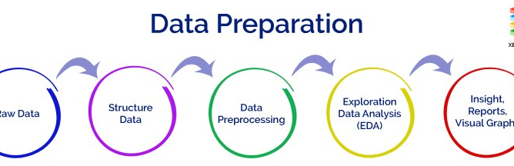
DATA PREParation
Pre-processing refers to the transformations applied to our data before feeding it to the algorithm. Data Pre-processing is a technique that is used to convert the raw data into a clean data set. In other words, whenever the data is gathered from different sources it is collected in raw format which is not feasible for the analysis. Pre-processing is the first step while creating the machine learning model. It is the process of converting raw dataset into cleaned dataset. Raw data contains noise, missing values, duplicate values which is not suitable for machine learning model. So, pre-processing is required for cleaning the data and making itsuitable for machine learning model.

Slide 18
CORRELATION
• Correlation is a statistical measure that indicates the extent to which two or more variables fluctuate together.
• A positive correlation indicates the extent to which those variables increase or decrease in parallel.
• A negative correlation indicates the extent to which one variable increases as the other decreases.

Slide 19
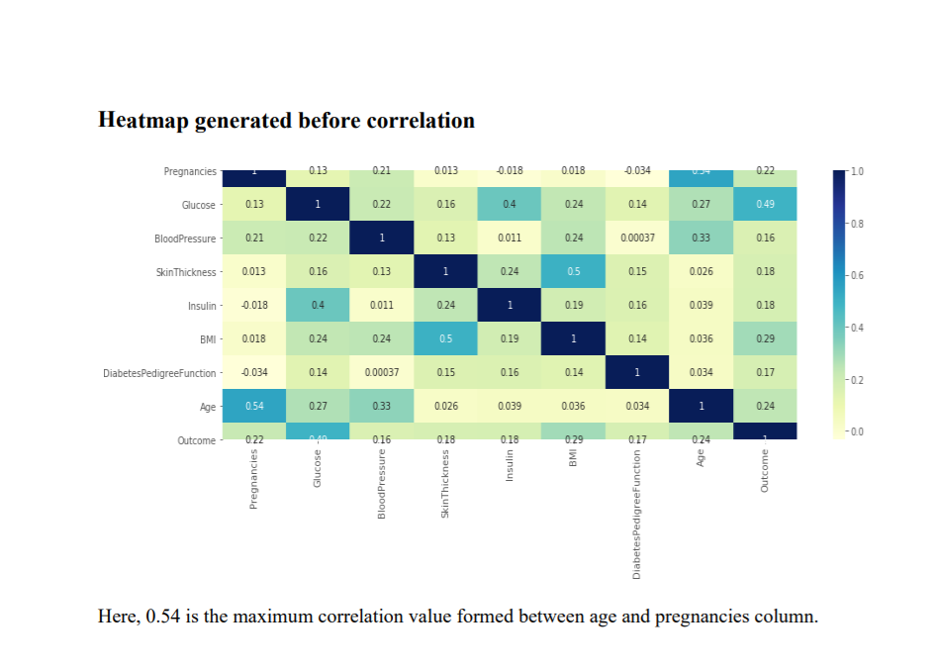

Slide 20
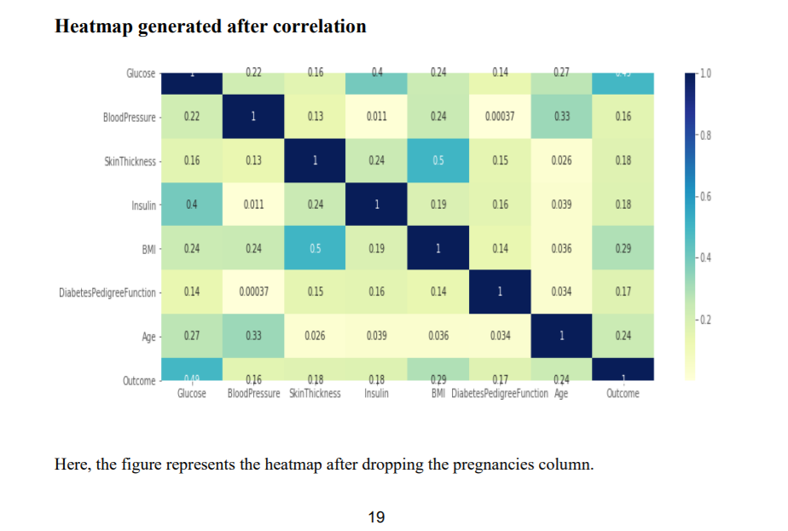

Slide 21
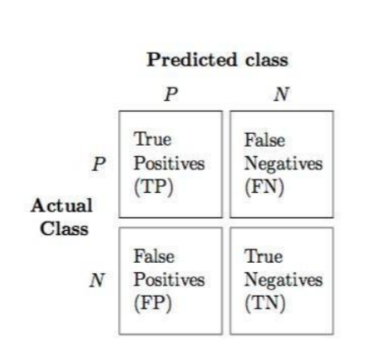
CONFUSION MATRIX
A confusion matrix is a table that is often used to describe the performance of a classification model (or "classifier") on a set of test data for which the true values are known.

Slide 22
Sensitivity or Recall or hit rate or true positive rate (TPR) It is the proportion of individuals who actually have the disease were identified as having the disease. TPR = tp / (tp + fn)
Specificity, selectivity or true negative rate (TNR) It is the proportion of individuals who actually do not have the disease were identified as not having the disease. TNR = tn / (tn + fp) =1-FPR
Precision or positive predictive value (PPV) If the test result is positive what is the probability that the patient actually has the disease. PPV = tp / (tp + fp)

Slide 23
Negative predictive value (NPV) If the test result is negative what is the probability that the patient does not have disease. NPV = tn / (tn + fn)
Miss rate or false negative rate (FNR) It is the proportion of the individuals with a known positive condition for which the test result is negative. FNR = fn / (fp + tn)
Fall-out or false positive rate (FPR) It is the proportion of all the people who do not have the disease who will be identified as having the disease. FPR = fp/ (fp + tn)

Slide 24
False discovery rate (FDR) It is the proportion of all the people identified as having the disease who do not have the disease. FDR = fp / fp + tp
False omission rate (FOR) It is the proportion of the individuals with a negative test result for which the true condition is positive. FOR = fn / (fn + tn)
Accuracy The accuracy reflects the total proportion of individuals that are correctly classified. ACC = ( tp + tn ) / (tp + tn + fp + fn)

Slide 25
F1 SCORE It is the harmonic mean of precision and sensitivity F1 = 2tp / (2tp+ fp + fn)
RMSE SCORE Root mean square of the error that has occurred between the test values and the predicted values.

Slide 26
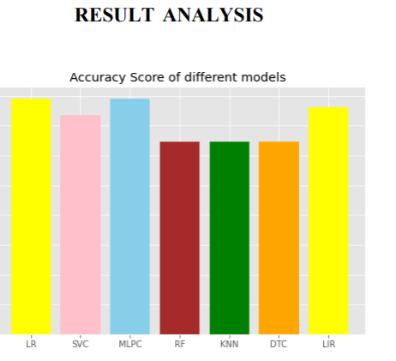
Comparison of Algorithms

Slide 27
conclusion
We have used 6 algorithms like Logistic Regression, Support Vector Machine, Decision Tree Classifier, Random Forest Classifier, K-nearest Neighbors Classifier. The accuracy varies for different algorithms on using different techniques. The accuracies after applying feature selection are - The accuracy for Logistic Regression algorithm is 79.66%, The accuracy for Support Vector Classifier algorithm is 60.91%, The accuracy for Decision Tree algorithm is 69.09% , The accuracy for Random Factor algorithm is 79.45% ,The accuracy for KNN algorithm is 78.70% which is the highest accuracy

Slide 28
References
https://www.kaggle.com/uciml/pima-indians-diabetes-database/data
https://towardsdatascience.com/chi-square-test-for-feature-selection-inmachine- learning-206b1f0b8223
https://towardsdatascience.com/train-test-split-and-cross-validation-inpython- 80b61beca4b6
https://machinelearningmastery.com/feature-selection-machine-learning-python/
https://medium.com/@aneesha/recursive-feature-elimination-with-scikitlearn- 3a2cbdf23fb7
https://medium.com/@saeedAR/smote-and-near-miss-in-python-machinelearning- in-imbalanced-datasets-b7976d9a7a79

